Slide 1
Early Detection of Brain Tumor in MRI Images using Open by Reconstruction and Convolution Neural Networks
Dayakshini Sathish, Sathish Kabekody, and Reshma K J (2023)
Group Number:
21141064 Basit Hussain
RA:
ST:

Slide 2
Introduction
MRI is a non-invasive imaging method for studying the human body's internal structure and function.
MRI images are categorized as T1-weighted and T2-weighted, but they are often affected by noise.
Manual analysis of brain MRI images is time-consuming and challenging due to noise interference.
Computer-Aided Detection (CAD) systems assist in accurate and efficient brain tumor diagnosis.
This paper presents an intelligent CAD system for automatic brain tumor detection and classification.
Malignant brain tumors, including High-Grade Glioma (HGG), are life-threatening and require early detection.

Slide 3
Objective
Develop an intelligent Computer-Aided Detection (CAD) system for automatic brain tumor detection and classification.
Reduce the time-consuming and challenging process of manually analyzing noisy brain MRI images.
Improve the accuracy of brain tumor diagnosis, especially in distinguishing malignant tumors, including High-Grade Glioma (HGG), which can be life-threatening.

Slide 4
Methodology
CAD System Development Sequence
Data Set
Pre-Processing
Filtering
Skull Stripping
Open by Reconstruction
Thresholding Segmentation

Slide 5
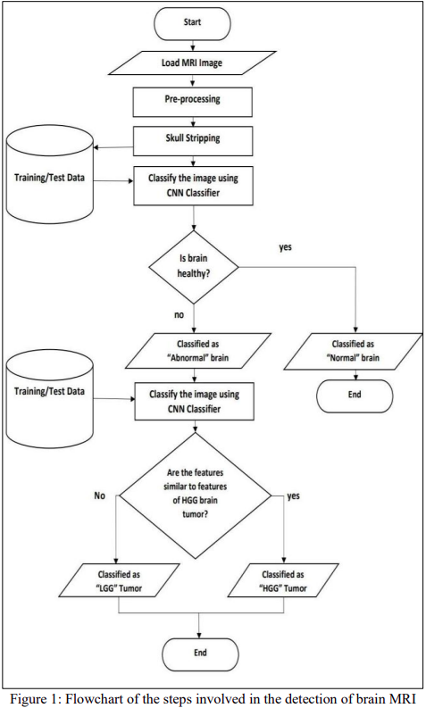

Slide 6
Results and Discussion
The CAD system sequentially processes brain MRI images, beginning with pre-processing and skull stripping.
Two CNNs are employed for classification, where the first CNN distinguishes normal and abnormal brain images, and the second CNN identifies tumor type.
The achieved accuracy for the first CNN is 92.3%, with a sensitivity of 87.17% and specificity of 97.43%. The second CNN attains an accuracy of 98.4% for classifying HGG.
Limitations include the system's compatibility with only axial anatomical planes, not covering sagittal and coronal planes.

Slide 7
Conclusion
Extend testing to larger datasets with diverse age groups and anatomical views of brain MRI for increased accuracy and applicability to other medical domains.
Enhance the system's compatibility with multiple anatomical planes and MRI image types, such as T1-weighted and flair type MRI images.

Slide 8
Future Work
presented a CAD system for brain MRI image classification.
The system processes images through pre-processing, skull stripping, and two CNNs for classification.
Achieved accuracy: First CNN - 92.3%, Second CNN - 98.4% for HGG classification.
System limitations: Works only with axial anatomical planes.

Slide 9
Thank you!

